Slide 1
Hadoop…….
Hadoop was created by computer scientists Doug Cutting and Mike Cafarella in 2006 to support distribution for the Nutch search engine.
It was inspired by Google's MapReduce, a software framework in which an application is broken down into numerous small parts. Any of these parts, which are also called fragments or blocks, can be run on any node in the cluster.
After years of development within the open source community, Hadoop 1.0 became publically available in November 2012 as part of the Apache project sponsored by the Apache Software Foundation.

Slide 2
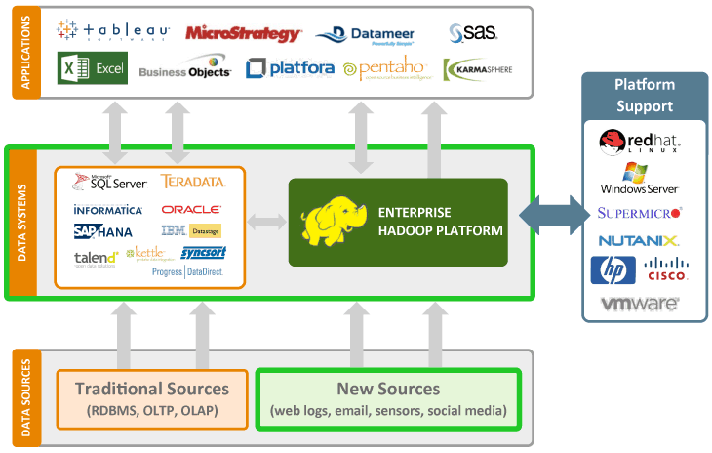

Slide 3
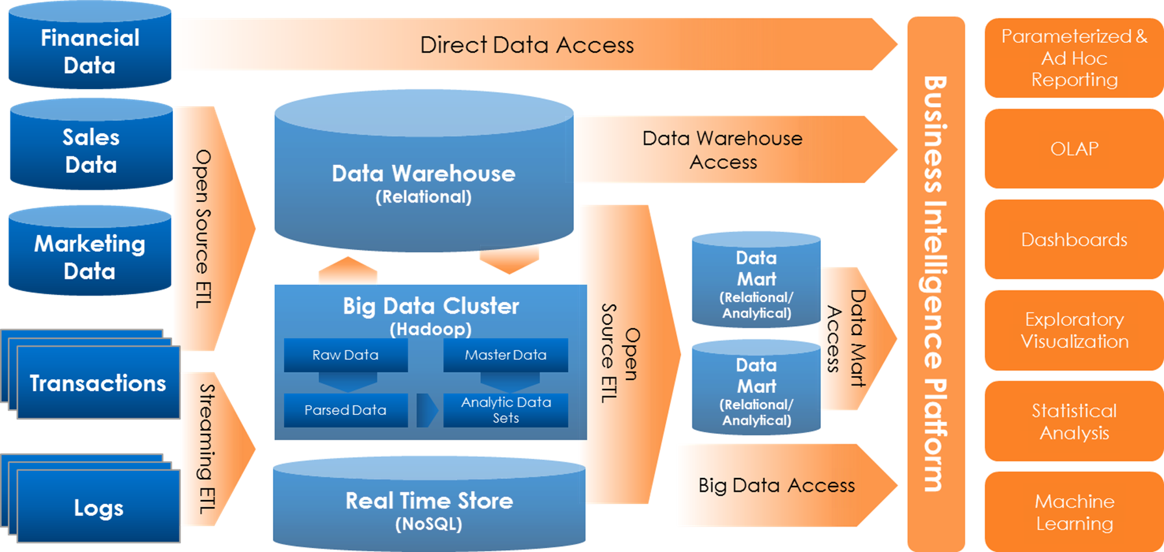

Slide 4
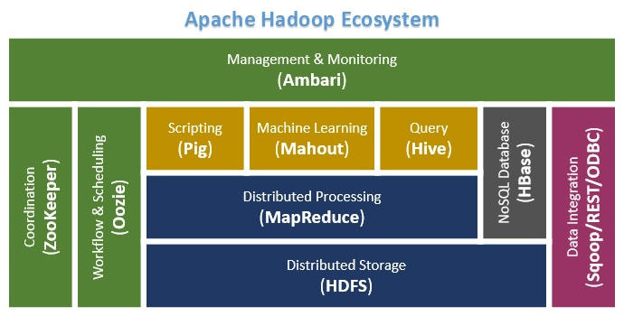

Slide 5
Hadoop…..
Flume. A tool used to collect, aggregate and move huge amounts of streaming data into HDFS.
HBase. An open source, nonrelational, distributed database;
Hive. A data warehouse that provides data summarization, query and analysis;
Cloudera Impala. A massively parallel processing database for Hadoop, originally created by the software company Cloudera, but now released as open source software;
Oozie. A server-based workflow scheduling system to manage Hadoop jobs;

Slide 6
Hadoop…..
Apache Phoenix. An open source, massively parallel processing, relational database engine for Hadoop that is based on Apache HBase;
Pig. A high-level platform for creating programs that run on Hadoop;
Sqoop. A tool to transfer bulk data between Hadoop and structured data stores, such as relational databases;
Spark. A fast engine for big data processing capable of streaming and supporting SQL, machine learning and graph processing;
Apache Storm. An open source data processing system; and
ZooKeeper. An open source configuration, synchronization and naming registry service for large distributed systems.

Slide 7
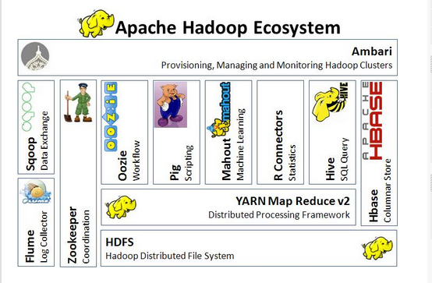

Slide 8
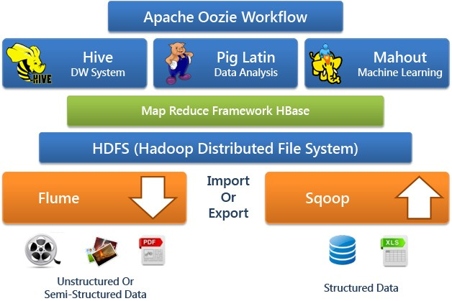

Slide 9
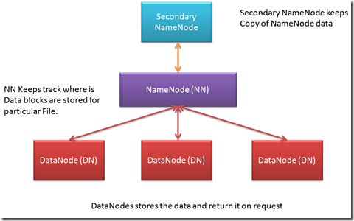

Slide 10
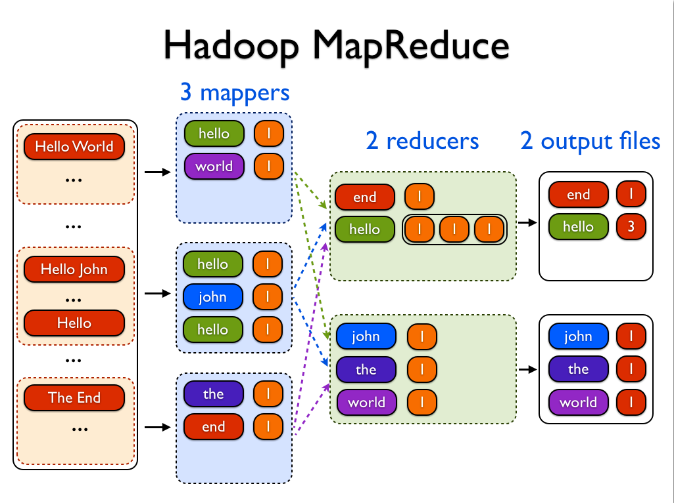

Slide 11
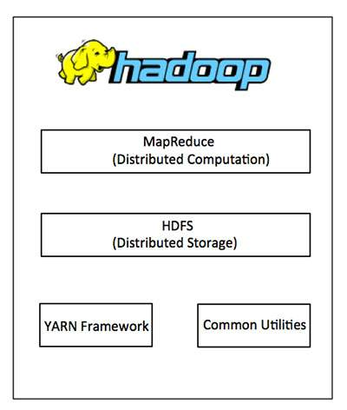
Hadoop Architecture

Slide 12
Hadoop Architecture
Hadoop framework includes following four modules:
Hadoop Common: These are Java libraries and utilities required by other Hadoop modules. These libraries provides filesystem and OS level abstractions and contains the necessary Java files and scripts required to start Hadoop.
Hadoop YARN: This is a framework for job scheduling and cluster resource management.
Hadoop Distributed File System (HDFS™): A distributed file system that provides high-throughput access to application data.
Hadoop MapReduce: This is YARN-based system for parallel processing of large data sets.

Slide 13
Hadoop Architecture
Since 2012, the term "Hadoop" often refers not just to the base modules mentioned above but also to the collection of additional software packages that can be installed on top of or alongside Hadoop, such as Apache Pig, Apache Hive, Apache HBase, Apache Spark etc.

Slide 14
